Slide 1
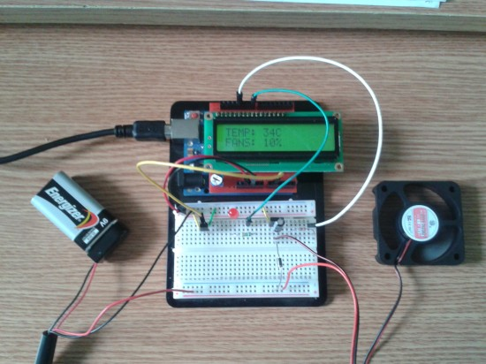
TEMPERATURE BASED FAN SPEED CONTROLLER

Slide 2
INTRODUCTION
THE IDEA BEHIND THIS PROJECT IS TO CONTROL THE SPEED OF FAN USING MICROCONTROLLER BASED ON VARIATION IN TEMPERATURE.
TEMPERATURE CONTROLLED FAN IS AN ALTERNATIVE WAY TO DEAL WITH THE SPEED OF MOTOR.
TEMPERATURE CONTROL IS A PROCESS IN WHICH THE TEMPERATURE OF SURROUNDING AREA IS MEASURED AND THE PASSAGE OF HEAT ENERGY INTO AND OUT OF IS ADJUSTED TO ACHIEVE A DESIRED TEMPERATURE.

Slide 3
OBJECTIVES
MEASURE THE ROOM TEMPERATURE.
DISPLAY THE CURRENT TEMPERATURE IN LCD.
VARY THE SPEED OF FAN ACCORDINGLY.
REDUCING THE POWER CONSUMPTION.
TO ASSIST PEOPLE WHO ARE DISABLED AND ARE UNABLE TO CONTROL THE SPEED OF FAN.
MONITORING CHANGES IN ENVIRONMENT.
ALSO CAN BE USED IN DIFFERENT INDUSTRIES AND ELECTRONIC DEVICES.

Slide 4
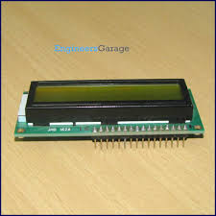
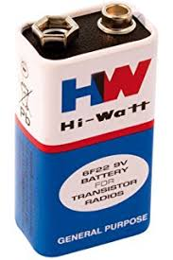
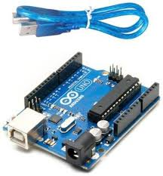
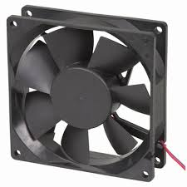
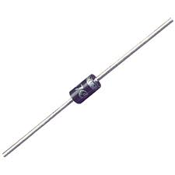
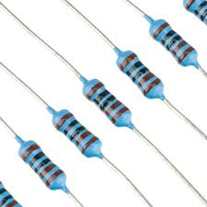
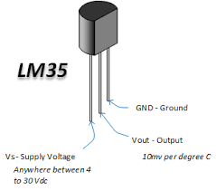
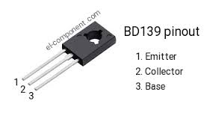
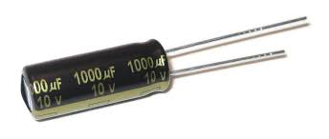
COMPONENTS
ARDUINO UNO.
FAN~12V
LM35 SENSOR
BD139 TRANSISTOR.
1K RESISTOR.
16*2 LCD.
1N4007 DIODE.
9V BATTERY.
CAPACITOR.

Slide 5
FLOWCHART
TEMPERATURE SENSOR
ARDUINO UNO
FAN
LCD

Slide 6
OVERVIEW
MICROPROCESSOR FORMS THE PROCESSING PART.
IN TEMPERATURE CONTROLLER CIRCUIT,THERE ARE TWO PARTS CONSISITING OF:
LM35 INTERFACING WITH ARDUINO UNO.
LCD INTERFACING WITH ARDUINO UNO.
3. THE HARDWARE CIRCUIT OF TEMPERATURE CONTROLLER NEEDS THE PROGRAMMING PART.

Slide 7
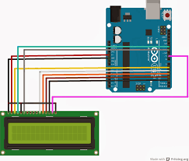
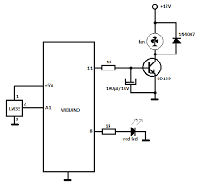
CIRCUIT

Slide 8
WORKING
THE CIRCUIT WORKS ON THE FEEDBACK PRINCIPLE .THE SPEED OF THE FAN VARIES WITH VARIATION IN TEMPERATURE.THE SPEED OF FAN INCREASES IF THE TEMPERATURE INCREASES AND THE SPEED OF FAN DECREASES WITH DECREASE IN TEMPERATURE.
LM35 PRODUCES ITS OUTPUT VOLTAGE CORRESPONDING TO TEMP.THE TEMP CONVERTS THE ANALOG VOLTAGE INTO DIGITAL FORM.
THE OUTPUT IS GIVEN AS INPUT TO THE ARDUINO UNO AND THE DISPLAYED ON LCD.

Slide 9
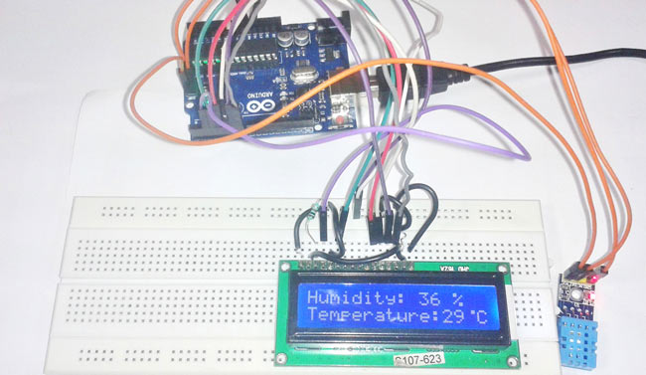

Slide 10
APPLICATIONS
USEFUL FOR COOLING THE PROCESSOR IN LAPTOPS AND PERSONAL COMPUTERS MORE EFFICIENTLY.
SMALL SCALE INDUSTRIES FOR COOLING THE ELECTRICAL/MECHANICAL EQUIPMENT.
TEMPERATURE BASED CONTROL OPERATIONS.

Slide 11
FUTURE SCOPE
WE CAN MONITOR MORE PARAMETERS LIKE HUMIDITY,LIGHT AND AT THE SAME TIME CONTROL THEM.
WE CAN SEND DATA TO A REMOTE LOCATION USING MOBILE OR INTERNET.
WE CAN DRAW GRAPHS OF VARIATIONS IN THESE PARAMETERS USING COMPUTER.
WHEN TEMPERATURE EXCEEDS THE LIMIT,A CALL WILL BE DIALED TO THE RESPECTIVE GIVEN NUMBER BY AN AUTOMATIC DIALER SYSTEM.

Slide 12


